Slide 1
From geometry to meaning
DAY 09 OF 16 · 3D & 6DOF STREAMING
Teach the computer what the points are, ground, walls, trees, objects, so a stream can send the important things first.
PCA features
RANSAC
DBSCAN
Evaluation
Semantics for streaming
Book: Ch. 6–7, 9, 12 · Code: day09_scene_understanding/
Notes:
Today compresses several book chapters into one session: local features from PCA (Chapters 6 and 7), RANSAC shape detection (Chapter 9) and DBSCAN clustering (Chapter 12). Keep the depth moderate; the goal is that students understand each tool well enough to use it for smart streaming.

Slide 2
Each point’s neighbourhood has a shape
BOOK CH. 6–7 · FEATURES
PCA
Planarity
Take the 50 nearest neighbours; the eigenvalues λ1 ≥ λ2 ≥ λ3 of their covariance describe the local shape.
(λ2 − λ3) / λ1: high on walls, roofs and ground.
Sphericity
Verticality
λ3 / λ1: high where points scatter in all directions, like foliage.
From the normal (smallest eigenvector): ≈ 1 on walls and trunks, ≈ 0 on the ground.
Day 09 · Scene understanding
2
Notes:
The book’s Chapter 7 computes covariance matrices, eigenvalues and eigenvectors per neighbourhood and derives planarity, linearity, omnivariance and verticality. Explain intuitively: if the neighbourhood is a flat disc, two eigenvalues are big and one is tiny; if it is a line, one is big; if it is a blob, all three are similar. The lab prints the mean features per true class: verticality is 0.01 for ground, 0.69 for walls and 0.94 for trunks; sphericity is highest for windows and foliage. Ask: which feature would you use to find walls? Verticality plus planarity.

Slide 3

RANSAC finds a plane by voting
BOOK CH. 9 · RANSAC
01
02
03
04
Sample
Fit
Count
Keep the best
Pick 3 random points.
They define a plane.
How many points lie within 5 cm?
Repeat 500 times; keep the plane with most inliers.
Lab result: the ground plane with 98% precision and 99.8% recall against the true labels.
Day 09 · Scene understanding
3
Notes:
The book builds RANSAC from scratch in Chapter 9, and so does our script, in about 15 lines. RANSAC means RANdom SAmple Consensus. Its strength is robustness: even if 60 percent of the points are not on the plane, a random triple from the plane wins the vote eventually. Result in the lab: normal (0, 0, 1), ground precision 98 percent, recall 99.8 percent. Ask: how would you find the second biggest plane? Remove the inliers and run again (the book’s multi-RANSAC).

Slide 4
DBSCAN groups what touches
BOOK CH. 12 · DBSCAN
Rule
Strengths
Lab result
A point with at least 10 neighbours within 0.5 m is a core point; connected core points form a cluster.
No need to say how many clusters; finds any shape; labels noise.
7 objects: the house, 4 trees, the car and the sphere, plus 60 noise points.
01
02
03
Day 09 · Scene understanding
4
Notes:
After removing the ground, the remaining objects are separated by empty space, so density-based clustering separates them. The book compares DBSCAN with k-means and notes k-means needs the number of clusters and prefers round clusters. The two parameters, eps and min points, need tuning: Lab L5 and the README exercise change eps to 0.2 and 1.5 to show splitting and merging.

Slide 5
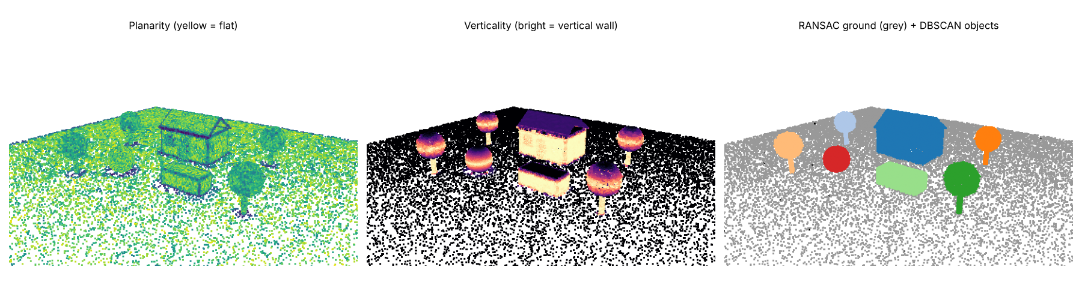
Features, ground and objects
LAB RESULT
Left: planarity. Middle: verticality. Right: RANSAC ground (grey) and DBSCAN objects (colours).
Day 09 · Scene understanding
5
Notes:
Point at the middle panel: walls and trunks are bright, roofs and ground dark. On the right each object has its own colour. This gives us a semantic scene with no training data at all, which is enough for many streaming decisions.

Slide 6
Semantics makes streaming smarter
BACK TO STREAMING
Priority
Quality budget
Interaction
Send people, faces and objects of interest first; ground and sky later.
Spend bits where viewers look: objects, not the floor.
Clickable objects, occlusion with real objects in AR, physics.
01
02
03
Day 09 · Scene understanding
6
Notes:
Close the loop to the course theme. Volumetric video research often gives the human region more bits than the background. In Mini-project P3 students can use today’s labels as an importance score for tile priority. 3 minutes.

Slide 7
Segment the street scene
HANDS-ON LAB · COPY, RUN, LOOK
RUN IT
cd day09_scene_understanding
python segment_scene.py
→ Read the feature table per class.
→ Read the object list from DBSCAN.
→ Change eps to 0.2 and 1.5.
Day 09 · Scene understanding
7
Notes:
Run, read the tables, then exercises: change eps, run RANSAC a second time on non-ground points, extract walls with verticality greater than 0.8. Lab L5 question 1 asks for a rule-based classifier with precision and recall per class. 30 minutes.

Slide 8
Three things to remember
1
PCA of a neighbourhood gives planarity, sphericity and verticality per point.
2
RANSAC fits shapes by random voting; DBSCAN groups points that touch.
3
Labels let a stream spend its bytes on what matters.
BEFORE NEXT SESSION
Lab L5 question 1. Next: surfaces, mesh LoDs and Gaussian splats.
Day 09 · Scene understanding
8
Notes:
Recap and preview Day 10: turning points into surfaces, simplifying them into Levels of Detail, and the new kid on the block, 3D Gaussian splatting.

Slide 9
Surfaces, mesh LoDs & splats
DAY 10 OF 16 · 3D & 6DOF STREAMING
From points to watertight meshes, from heavy meshes to light ones, and why 3D Gaussian splats look so real.
Poisson meshing
Mesh LoDs
NeRF
Gaussian splats
What to stream?
Book: Ch. 10, 18 · Code: day10_surfaces_neural/
Notes:
This session uses the book’s Chapter 10 (high-fidelity meshing, Poisson, levels of detail, voxelisation) and Chapter 18 (3D Gaussian splatting). It is the last session of the 3D-foundations half of the course; from Day 11 on we focus on viewing and streaming.

Slide 10
Poisson reconstruction: a smooth surface through the points
BOOK CH. 10
Input
Idea
Depth
Points with consistent normals (Day 8).
Find an inside/outside function whose gradient matches the normals; the surface is its zero level.
Octree depth controls detail: depth 8 gave 117k triangles from 30k points.
01
02
03
Day 10 · Meshes, LoDs, splats
2
Notes:
The book discusses several meshing strategies; Poisson is the most common for scanned data because it produces watertight surfaces and tolerates noise. Explain the inside/outside idea with a 2D drawing: the normals point outward, Poisson finds a smooth function that is positive inside and negative outside. The octree depth again: higher depth means finer cells, more triangles. Common issue: Poisson invents surface where there is no data (bubbles); the density output helps trim it.

Slide 11
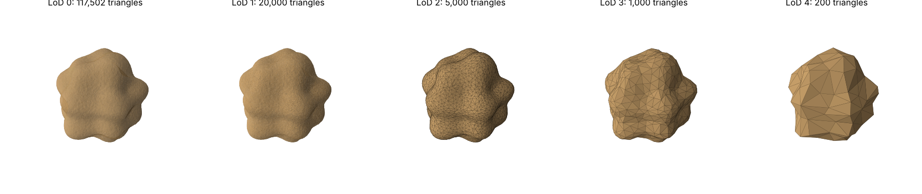
Mesh LoDs: 117k → 200 triangles
BOOK CH. 10 · LEVELS OF DETAIL
4.3 MB, 753 KB, 189 KB, 38 KB, 8 KB. From far away, LoD 3 looks the same as LoD 0.
Day 10 · Meshes, LoDs, splats
3
Notes:
The book’s section ‘Levels of Detail Creation’ simplifies meshes for different viewing distances. Quadric decimation collapses edges while keeping the shape error low. Ask the class: at what distance does LoD 3 (1,000 triangles) look the same as LoD 0? This depends on screen pixels, the idea of screen-space error, which 3D Tiles uses to choose LoDs. Lab L5 question 2 asks students to measure it with PSNR.

Slide 12
Radiance fields: from geometry to appearance
BOOK CH. 18
Photogrammetry
NeRF (2020)
3D Gaussian Splatting (2023)
Points and textured meshes; struggles with glass, reflections, hair.
A neural network maps (position, direction) → colour and density. Photo-real, but slow to train and render.
Millions of coloured, oriented, semi-transparent ellipsoids. Photo-real AND real-time.
01
02
03
Day 10 · Meshes, LoDs, splats
4
Notes:
Follow the book’s narrative in Chapter 18: photogrammetry and SfM work well for textured, matte surfaces but produce artefacts for transparency, reflections and fine details; NeRF (Mildenhall et al., 2020) handles those but needs heavy training and rendering; 3D Gaussian Splatting (Kerbl et al., 2023) keeps the realism and renders in real time by rasterising Gaussians instead of ray-marching a network. The book notes Gaussian splatting does not need polygons or meshes and uses Gaussian distributions to capture and render details.

Slide 13
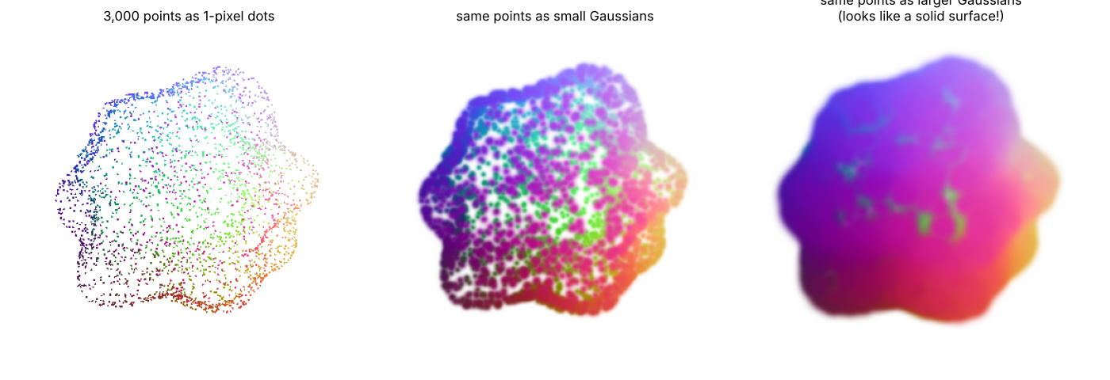
Why splats look solid
LAB PREVIEW
■ Back-to-front sort + alpha blending
■ Size shrinks with distance
■ Real 3DGS: 59 floats ≈ 236 B per splat
■ vs 15 B per coloured point
Same 3,000 points. Drawn as soft, blended Gaussians, the gaps disappear and the surface looks continuous.
Day 10 · Meshes, LoDs, splats
5
Notes:
Our toy renderer sorts points back to front and alpha-blends a 2D Gaussian for each. That is the heart of 3DGS rendering; real splats are also anisotropic (stretched ellipses), oriented, and have view-dependent colour via spherical harmonics. Data cost: each splat stores position (3), scale (3), rotation (4), opacity (1) and 48 spherical-harmonic colour coefficients: 59 floats, about 236 bytes, versus 15 bytes for a coloured point. Compressing and streaming splats is an active research area, a good capstone track.

Slide 14
Points, meshes or splats?
CHOOSING WHAT TO STREAM
 | Points | Meshes | Gaussian splats
Bytes per primitive | ≈ 15 B | ≈ 30–50 B / triangle | ≈ 236 B (uncompressed)
Look | Holes up close | Clean surfaces | Photo-real, soft
Progressive LoD | Easy (octree) | Possible (decimation) | Research topic
Standards | MPEG G-PCC / V-PCC | glTF, 3D Tiles | Emerging
Day 10 · Meshes, LoDs, splats
6
Notes:
Summarise the trade-offs. Mesh bytes depend on encoding: with float32 positions and shared vertices, a triangle costs roughly 30 to 50 bytes before compression. The point is not exact numbers but the shape of the trade-off: splats look best and cost most, points are easiest to make progressive. Most of our streaming sessions use points because they make the mechanics visible.

Slide 15
Mesh, simplify, splat
HANDS-ON LAB · COPY, RUN, LOOK
RUN IT
cd day10_surfaces_neural
python mesh_lod_and_splats.py
→ Read the LoD table: triangles vs file size.
→ Open outputs/rock_lod*.ply.
→ Compare the three panels of gaussian_splats.png.
Day 10 · Meshes, LoDs, splats
7
Notes:
Run, then exercises: change Poisson depth from 6 to 10, add a 50-triangle LoD, scale splats by local spacing. Announce mini-project P2 (LoD builder), due at Day 12. 30 minutes.

Slide 16
Three things to remember
1
Poisson turns oriented points into a watertight mesh; depth sets detail.
2
Mesh LoDs shrink 117k triangles to 200 for distant views.
3
Gaussian splats look photo-real but cost ~16× more bytes per primitive than points.
BEFORE NEXT SESSION
Lab L5 and mini-project P2 (LoD builder). Next: the second half, viewing and streaming.
Day 10 · Meshes, LoDs, splats
8
Notes:
Recap the first half: data, representations, capture, structures, cleaning, meaning, surfaces. Next session begins the streaming half with rendering and a real 6DoF viewer in the browser.

Slide 17
Rendering & the 6DoF viewer
DAY 11 OF 16 · 3D & 6DOF STREAMING
How a viewer turns a 6DoF pose into a picture 60 times a second, and why it only ever needs part of the scene.
Render pipeline
View frustum
Culling
A browser 6DoF viewer
Pose traces
Book: Ch. 5, 17 · Code: day11_rendering_6dof_viewing/
Notes:
Second half of the course starts. The book’s Chapter 5 builds a multimodal 3D viewer in Python and Chapter 17 discusses visualisation of large scenes. We go to the browser with three.js because that is where most 6DoF streaming clients run.

Slide 18
From 3D points to pixels, every frame
RENDERING
01
02
03
04
Pose
View matrix
Projection
Cull & draw
Read the 6DoF pose from mouse, keyboard or headset.
Inverse pose: world → camera (Day 2).
Pinhole K: camera → image (Day 6).
Skip what is outside the view; z-buffer keeps the nearest.
Day 11 · Rendering & 6DoF viewing
2
Notes:
Every piece is something students already know. The renderer applies the inverse of the viewer pose to bring the world into camera coordinates, projects with the intrinsics, and keeps the nearest point per pixel in a depth buffer (our NumPy renderer in common/course3d.py does exactly this in 30 lines; ask students to read it). On a GPU this runs for millions of points per frame. At 90 frames per second in a headset the whole loop has about 11 ms.

Slide 19
The view frustum: a pyramid of what you can see
CULLING
Six planes
Test
Payoff
Near, far, left, right, top, bottom. Set by the field of view and aspect ratio.
A point is visible if it is in front of all six planes. For a tile, test its bounding sphere.
Looking away from the town, only 4% of the points are visible.
01
02
03
Day 11 · Rendering & 6DoF viewing
3
Notes:
Draw the frustum: a truncated pyramid from the eye. Explain the bounding sphere test we use later for tiles: a sphere is outside if its centre is more than its radius beyond any plane. The lab measures the visible share for four poses: 83 percent from a street corner, 37 percent near the door, 4 percent looking south, 83 percent from a drone.

Slide 20
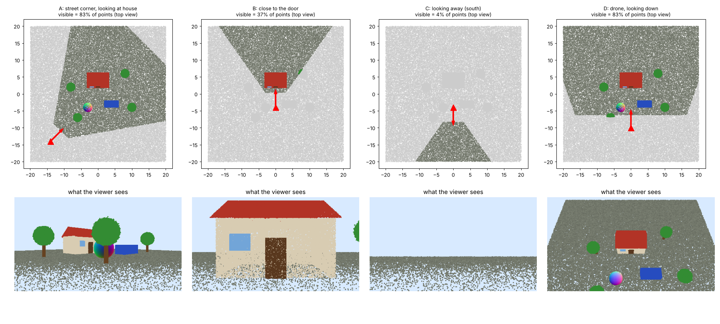
What each pose actually sees
LAB RESULT
Grey = outside the frustum. The visible share swings from 4% to 83% with the pose alone.
Day 11 · Rendering & 6DoF viewing
4
Notes:
Top row: top views with visible points in colour and the viewer as a red triangle. Bottom row: what the viewer sees. The key message for streaming: the share of the scene that matters changes every time the user turns. If we only send visible data, we save a lot, but we must react quickly when they turn, which is where prediction (Day 16) comes in.

Slide 21
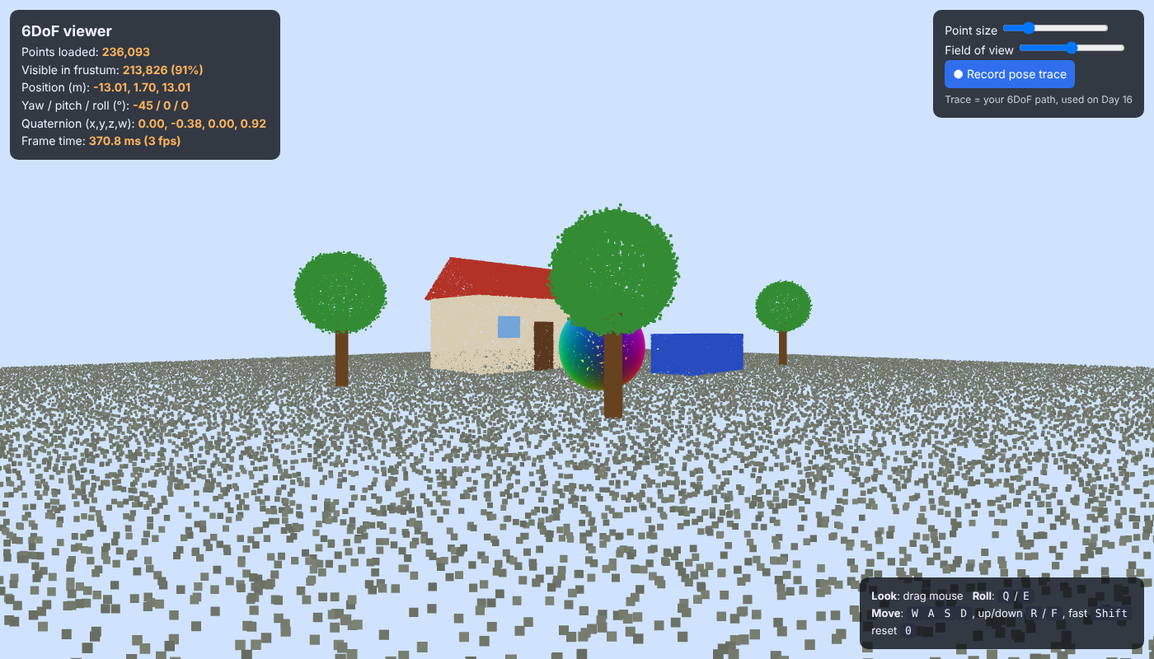
A real 6DoF point cloud viewer
BROWSER DEMO
■ 250k points rendered at interactive rates
■ ‘Visible in frustum’ updates live
■ ● Record → pose_trace.csv (for Day 16)
■ Same controls in every demo of the course
Fly with WASD, drag to look, Q/E to roll. The HUD shows the pose as position, Euler angles and quaternion.
Day 11 · Rendering & 6DoF viewing
5
Notes:
Run it live: python frustum_culling.py writes viewer6dof/scene.ply, then serve that folder with python -m http.server and open localhost:8000. Show the HUD values change as you move; the visible-in-frustum count updates every 15 frames. Change the field of view slider and watch the visible share change. The record button saves a pose trace CSV: time, position, quaternion, yaw/pitch/roll. Ask everyone to record a 30-second trace; Day 16 uses it for pose prediction.

Slide 22
Measure the frustum, then fly
HANDS-ON LAB · COPY, RUN, LOOK
RUN IT
cd day11_rendering_6dof_viewing
python frustum_culling.py
cd viewer6dof
python -m http.server 8000
# open http://localhost:8000
→ Open outputs/frustum.png.
→ Fly around; watch ‘Visible in frustum’.
→ Record a 30 s pose trace and keep the CSV.
Day 11 · Rendering & 6DoF viewing
6
Notes:
Lab time is mostly in the browser. Make sure every student saves a pose trace; they need it for Lab L6 and Day 16. If the page is blank, the most common causes are opening the file directly instead of through the http server, or no internet access to load three.js from the CDN. 30 minutes.

Slide 23
Three things to remember
1
Render loop: pose → view matrix → projection → cull → draw, every frame.
2
The view frustum shows that a viewer sees only a fraction of the scene.
3
A pose trace records 6DoF behaviour: the input for prediction and evaluation.
BEFORE NEXT SESSION
Lab L6 question 1 with your pose traces. Next: what streaming means in numbers.
Day 11 · Rendering & 6DoF viewing
7
Notes:
Recap and preview Day 12: bitrate, buffers, stalls and latency, the language of all streaming systems.

Slide 24
Streaming fundamentals
DAY 12 OF 16 · 3D & 6DOF STREAMING
Bitrate, bandwidth, buffers, stalls and latency: the vocabulary of every streaming system, from Netflix to volumetric video.
Data rates
Segments & manifests
Buffer & stalls
Latency
6DoF specifics
Book: beyond the book · Code: day12_streaming_fundamentals/
Notes:
From today the book is background rather than the main source. Introduce the basic concepts of media streaming as used in 2D video and explain how they change for 6DoF. Keep it numerical; the script prints all numbers.

Slide 25
Raw data rates of different media
HOW BIG IS IT?
Content | Raw rate | Typical compressed
HD video 1080p, 30 fps | ≈ 1.5 Gbit/s | ≈ 5 Mbit/s
360° video 8K, 30 fps | ≈ 21 Gbit/s | tens of Mbit/s
Volumetric 100k pts × 15 B, 30 fps | ≈ 360 Mbit/s | → Day 13
Volumetric 1M pts × 15 B, 30 fps | ≈ 3.6 Gbit/s | → Day 13
Day 12 · Streaming fundamentals
2
Notes:
These raw numbers come from the script’s Part A. 2D video codecs achieve compression ratios in the hundreds because neighbouring pixels and frames are similar. Point clouds are harder to compress because points are irregular. Typical home broadband is tens to hundreds of Mbit/s, mobile less, and it fluctuates. The compressed figures for 2D are typical service bitrates, not exact standards; say ‘about’.

Slide 26
Segments, a manifest and a client that decides
HOW STREAMING WORKS
01
02
03
04
Encode
Manifest
Client
Adapt
Cut content into short segments (1–4 s), each at several qualities.
A file listing segments, qualities and sizes (DASH .mpd, HLS .m3u8).
Downloads segments in order over plain HTTP.
Picks the quality of each next segment from throughput and buffer.
6DoF adds a new dimension to the choice: not only WHICH quality, but WHICH part of the scene.
Day 12 · Streaming fundamentals
3
Notes:
This is how DASH (MPEG-DASH, ISO/IEC 23009-1) and HLS work. The server is simple: a web server with files. All intelligence is in the client. Our Day 15 and 16 systems follow exactly this design: manifest.json plus binary chunks over HTTP. Ask: why put the intelligence in the client? Because only the client knows its own network conditions and, in 6DoF, its own pose.

Slide 27
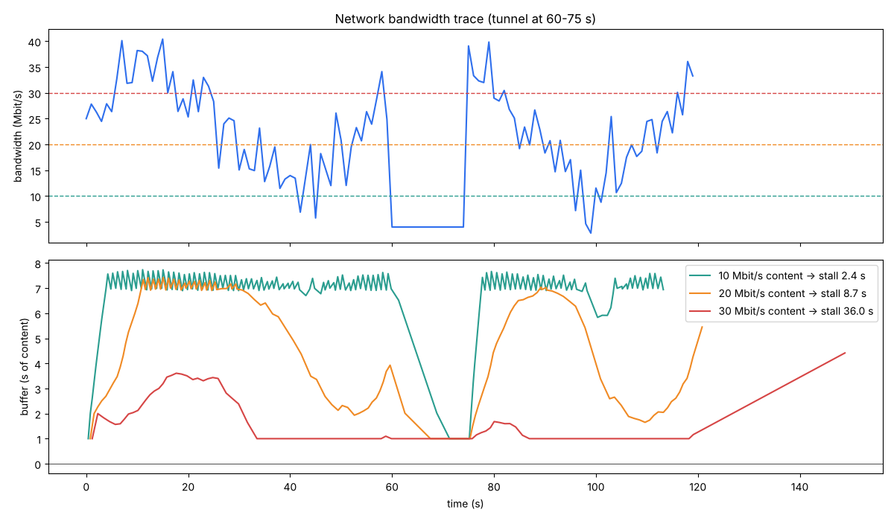
The buffer: your safety margin against bad networks
LAB RESULT
Content at 10 Mbit/s stalls 2.4 s; at 20 Mbit/s 8.7 s; at 30 Mbit/s 36 s. The tunnel at 60–75 s drains every buffer.
Day 12 · Streaming fundamentals
4
Notes:
Top: a bandwidth trace with a tunnel. Bottom: seconds of content waiting in the buffer. While download is faster than playback the buffer grows; when slower, it drains; when empty, playback freezes: a stall (rebuffering). Studies of video QoE consistently find stalls are the most annoying impairment, more than lower quality. So there is a trade-off: higher quality means more stalls. Adaptive bitrate (Day 16) is the fix.

Slide 28
Motion-to-photon: from head move to updated image
6DOF SPECIFICS
sensor 2 ms + pose 1 ms + render 11 ms + display 5 ms ≈ 19 ms
Target
Network RTT
Consequence
Below about 20 ms, or users notice lag and may feel sick.
A 40 ms round trip alone breaks the budget.
Render locally; stream the CONTENT ahead of time, not the pixels.
Day 12 · Streaming fundamentals
5
Notes:
This is the key design constraint of 6DoF streaming. The often-quoted target for VR is under 20 milliseconds motion-to-photon. Our budget is illustrative; real numbers depend on the device. If the server rendered each frame for the current pose, the network round trip would be inside the loop. So 6DoF systems send 3D content (or depth plus colour) ahead of time and render on the device; cloud-rendering systems use tricks like reprojection to hide latency. Lab L6 question 3 asks students to ping real servers and judge.

Slide 29
Simulate a stream with a buffer
HANDS-ON LAB · COPY, RUN, LOOK
RUN IT
cd day12_streaming_fundamentals
python bitrate_buffer_latency.py
→ Part A: raw rate table.
→ Part B: buffer_simulation.png and stall times.
→ Part C: the latency budget.
Day 12 · Streaming fundamentals
6
Notes:
Run, then exercises: change segment duration to 2 and 4 seconds, change the start-up buffer, design a train-ride bandwidth trace. Lab L6 question 2 asks for a simple ABR that beats fixed bitrates. 30 minutes.

Slide 30
Three things to remember
1
Raw 3D is hundreds of Mbit/s; networks give tens and fluctuate.
2
Streaming = segments + manifest + a client that adapts. The buffer absorbs dips; empty buffer = stall.
3
6DoF needs < 20 ms motion-to-photon, so content is streamed ahead and rendered locally.
BEFORE NEXT SESSION
Lab L6 and mini-project P2 due. Next: compressing point clouds.
Day 12 · Streaming fundamentals
7
Notes:
Recap. Next session we attack the first problem, data size, with point cloud compression: quantisation, octree coding (G-PCC) and video-based coding (V-PCC).

Slide 31
Compressing point clouds
DAY 13 OF 16 · 3D & 6DOF STREAMING
Quantise, code the octree, or turn it into video: the three ideas behind Draco and MPEG’s point cloud codecs.
Quantisation
D1 PSNR
Octree coding
Rate–distortion
V-PCC idea
Book: Ch. 4, 17 + MPEG · Code: day13_compression/
Notes:
Today students write a working octree geometry coder from scratch and see a toy version of V-PCC. Standards to name: MPEG G-PCC (ISO/IEC 23090-9) and V-PCC (ISO/IEC 23090-5), and Google’s open-source Draco library.

Slide 32
Quantisation: snap points to a grid
IDEA 1
How
Effect
Measure
Divide the bounding box into 2ᵇ steps per axis; store integers.
10 bits on a 6 m house = 6 mm steps; nearby points merge.
D1 PSNR: point-to-point error relative to the box diagonal. 10 bits → 69 dB, 6 bits → 45 dB.
01
02
03
Day 13 · Compression
2
Notes:
Quantisation is the main lossy step in almost every geometry codec. D1 is the MPEG point-to-point metric: for every point, the distance to the nearest point in the other cloud, in both directions, turned into a PSNR using the bounding-box diagonal as the peak (our implementation uses the diagonal; MPEG test conditions define the peak per dataset). Explain the table from the lab printout: 6 bits keeps 12k of 52k points, 10 bits keeps 52k.

Slide 33
Octree occupancy coding: 1 byte per node
IDEA 2 · G-PCC
byte = Σ 2ᶜ for each occupied child c ∈ {0…7}
Breadth-first
Empty space is free
Then entropy-code
Root byte, then each child’s byte, level by level.
An empty octant is one 0 bit, its whole subtree is skipped.
G-PCC uses context arithmetic coding; we use zlib.
Day 13 · Compression
3
Notes:
Walk through a tiny example on the board: a node with children 0, 3 and 7 occupied has byte 1 + 8 + 128 = 137. The decoder reads bytes in the same order and rebuilds every cell: geometry is implicit, no coordinates are sent. This is the geometry coder of MPEG G-PCC, designed for static scans and LiDAR. Our encoder is about 20 lines. Lab result: 10-bit geometry at about 12 bits per point, versus 96 bits per point for raw float coordinates, and the decoder checks that it rebuilds exactly.

Slide 34
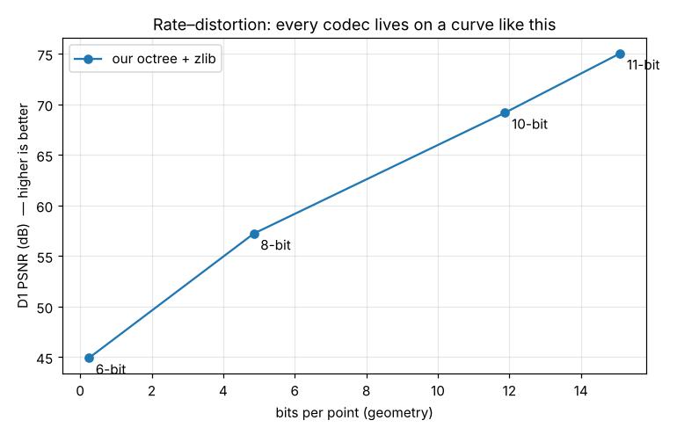
Every codec lives on a rate–distortion curve
LAB RESULT
■ Left = fewer bits, up = better quality
■ Each dot = one quantisation level
■ Codecs compete on the whole curve
■ Colour coded separately (attributes)
Our octree + zlib: 0.25 bits/point at 45 dB up to 15 bits/point at 75 dB. Install DracoPy to add Draco.
Day 13 · Compression
4
Notes:
Explain the axes: left is cheap, up is good. Each point on the curve is a quantisation level. Codecs are compared by whose curve is higher and further left. Real G-PCC beats our zlib version substantially because its arithmetic coder uses neighbour contexts to predict occupancy. Lab L7 asks students to add colour and Draco to this plot.

Slide 35
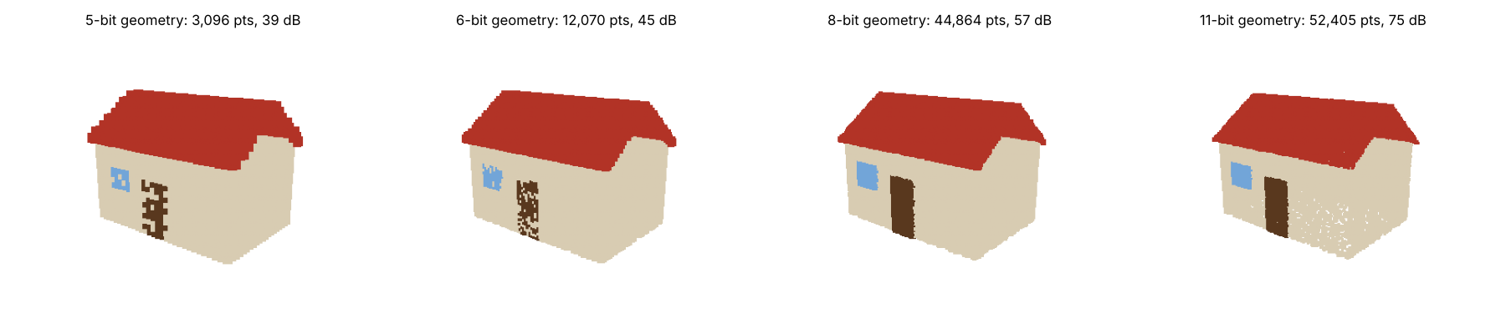
Quantisation you can see
WHAT THE NUMBERS LOOK LIKE
5 bits: blocky. 8 bits: fine for distant viewing. 11 bits: indistinguishable. Distance decides how many bits you need.
Day 13 · Compression
5
Notes:
This connects compression to LoD and to 6DoF: the number of bits a viewer needs depends on how far away the object is. A distant house at 8 bits looks perfect. That is why streaming systems combine compression with view-dependent choices (Day 14).

Slide 36
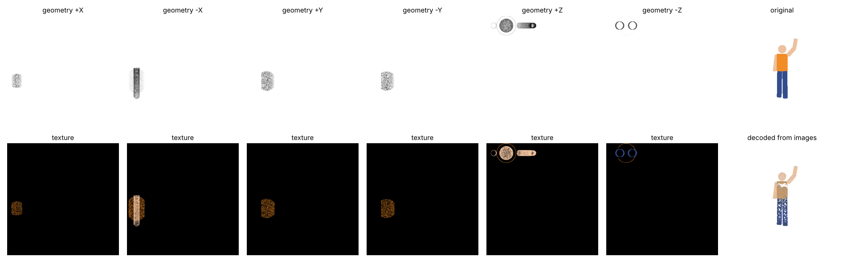
Turn 3D into images, use a video codec
IDEA 3 · V-PCC
6 depth images + 6 colour images → PNG/JPEG. 1.8 mm mean error; points hidden within a projection are lost.
Day 13 · Compression
6
Notes:
V-PCC projects patches of the point cloud onto 2D, packs them into geometry (depth) and texture (colour) videos plus an occupancy map, and compresses those with a standard video codec such as HEVC. Big advantage: phones already have hardware video decoders. Our toy uses 6 whole-object projections instead of patches, so points hidden inside a projection are lost: 15k of 52k come back. Real V-PCC uses many small patches and two depth layers to fix this; Lab L7 adds a second layer.

Slide 37
Write a codec, then draw its curve
HANDS-ON LAB · COPY, RUN, LOOK
RUN IT
cd day13_compression
python compress_pointcloud.py
python vpcc_projection_toy.py
pip install DracoPy # optional
→ Read quantisation and octree tables.
→ Open rate_distortion.png.
→ Open vpcc_toy.png and compare original vs decoded.
Day 13 · Compression
7
Notes:
Run both scripts. Read octree_encode and octree_decode together in class: they are the heart of the session. Exercises: Draco comparison, lower JPEG quality in V-PCC, try lzma. This is Lab L7. 35 minutes.

Slide 38
Three things to remember
1
Quantisation trades precision for bits; D1 PSNR measures the damage.
2
Octree occupancy coding (G-PCC) sends 1 byte per node and nothing for empty space.
3
V-PCC turns 3D into 2D videos to reuse video codecs and hardware.
BEFORE NEXT SESSION
Lab L7. Next: send only what the viewer can see.
Day 13 · Compression
8
Notes:
Recap. Next session we combine tiles, LoDs and the viewer’s pose into a viewport-adaptive streaming strategy.

Slide 39
Viewport-adaptive 6DoF streaming
DAY 14 OF 16 · 3D & 6DOF STREAMING
Tiles × levels of detail × the viewer’s pose: send the right detail, for the right part of the scene, at the right time.
Tiles
LoD per tile
Visibility & distance
Budgets
4 strategies compared
Book: beyond the book · Code: day14_viewport_adaptive/
Notes:
This is the core algorithm of 6DoF streaming. Everything comes together: octree LoDs (Day 7), frustum culling (Day 11), bytes and budgets (Days 12 and 13).

Slide 40
Four decisions per update
THE RECIPE
01
02
03
04
Tile
LoD
Select
Budget
Cut the scene into cells (here 5 m × 5 m).
Store each tile at 5 detail levels.
Outside frustum → skip. Far → coarse. Near → fine.
Never exceed the bytes the network allows.
Day 14 · Viewport-adaptive streaming
2
Notes:
Explain each design choice. Tiles let the client fetch parts of the scene independently. LoDs let it fetch cheap previews and refine. The pose decides which tiles and which LoDs. The budget comes from the network throughput estimate. Production systems (Cesium 3D Tiles, Potree) use hierarchical tiles and screen-space error instead of a fixed grid and distance, but the logic is identical.

Slide 41
Four strategies along the same camera path
LAB RESULT
Strategy | MB / update | vs. everything | Image PSNR
S1 Send everything, full detail | 5.67 | 100% | reference
S2 Frustum only, full detail | 3.05 | 54% | identical
S3 Frustum + distance LoD | 1.24 | 22% | 34.4 dB
S4 S3 within a 0.6 MB budget | 0.55 | 10% | 25.8 dB
Day 14 · Viewport-adaptive streaming
3
Notes:
Numbers from the lab. S2 shows culling alone halves the data with zero quality loss. S3 cuts to 22 percent by sending distant tiles coarsely, at a moderate image difference: point renders are noisy so PSNR is harsh, and visually the scene is very close. S4 enforces a hard budget with a greedy rule: start every visible tile at LoD 0, then repeatedly upgrade the tile with the best benefit per byte (close and cheap first). Ask: which strategy would you deploy on a 4G phone? S4, because it never exceeds the network.

Slide 42
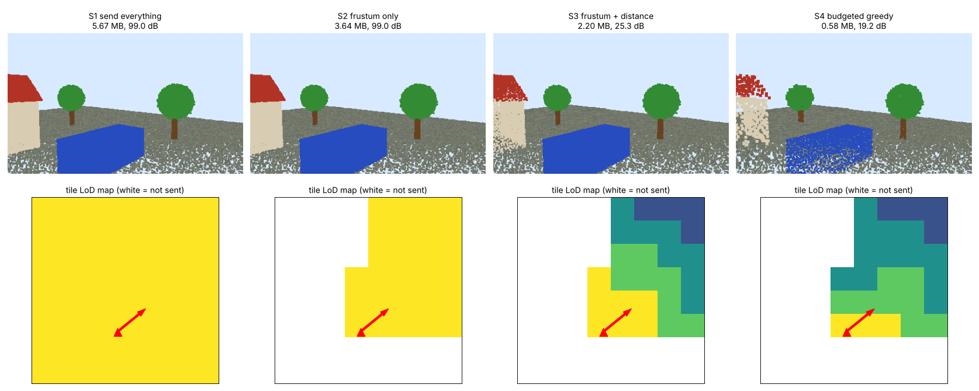
Tile LoD maps for one pose
WHAT THE CLIENT ASKS FOR
Bottom row: white tiles are not sent; brighter = finer LoD. The red arrow is the viewer.
Day 14 · Viewport-adaptive streaming
4
Notes:
Top: what the viewer sees with each strategy. Bottom: the tile map, which is literally the request list. S2 removes everything behind the viewer. S3 grades detail by distance. S4 does the same but caps the total. This map is what the Day 15 browser client draws live.

Slide 43
What makes this hard in practice
OPEN PROBLEMS
Latency
Quality metric
Fairness of bits
By the time a tile arrives the user has turned. → predict the pose (Day 16).
Distance is a proxy; screen-space error or perceptual metrics are better.
Semantics (Day 9): a face matters more than a wall.
01
02
03
Day 14 · Viewport-adaptive streaming
5
Notes:
These three cards are the menu for mini-project P3 and the capstone. Mention that research on viewport-adaptive point cloud streaming studies exactly these questions, for example adapting tiles and quality to predicted viewports and modelling quality perceptually.

Slide 44
Compare four streaming strategies
HANDS-ON LAB · COPY, RUN, LOOK
RUN IT
cd day14_viewport_adaptive
python viewport_adaptive.py
→ Read the strategy table.
→ Open strategies.png and tile_lod_maps.png.
→ Change BUDGET and re-run.
Day 14 · Viewport-adaptive streaming
6
Notes:
Run, then exercises: sweep BUDGET and plot PSNR, change tile size, add a frustum margin. Lab L8 question 1 adds a predicted-frustum strategy. Announce mini-project P3, due at Day 16. 30 minutes.

Slide 45
Three things to remember
1
Tiles × LoDs + the pose = what to request.
2
Culling alone halves the data; distance-based LoD cuts it to about a fifth.
3
A byte budget plus a benefit-per-byte rule keeps the stream inside the network.
BEFORE NEXT SESSION
Lab L8 question 1 and mini-project P3. Next: run it live over a network.
Day 14 · Viewport-adaptive streaming
7
Notes:
Recap. Next session is the most hands-on of the course: a live tiled 6DoF streaming server and browser client with adjustable bandwidth.

Slide 46
A live 6DoF streaming system
DAY 15 OF 16 · 3D & 6DOF STREAMING
A Python server, a browser client, a simulated network: walk through a streamed world and watch every byte.
Architecture
Manifest & chunks
Client logic
Throughput
Experiments
Book: beyond the book · Code: day15_live_6dof_streaming/
Notes:
Today is mostly lab. Explain the architecture in 20 minutes, then let students experiment for an hour. The system is small enough to read in class: server.py about 150 lines, client about 250 lines.

Slide 47
A dumb server and a smart client
ARCHITECTURE
01
02
03
04
Package
Manifest
Link
Client
Server tiles the scene, makes 5 LoDs per tile, encodes 9 B/point.
manifest.json: tiles, bounding spheres, LoD sizes.
Every chunk passes through a shared, rate-limited link.
Every 150 ms: frustum, distance, throughput → next requests.
Day 15 · Live 6DoF streaming
2
Notes:
The design copies DASH: the server only serves files, the client decides. Encoding: 16-bit quantised coordinates per tile plus 8-bit colour, 9 bytes per point instead of 15 (quantisation from Day 13). The simulated link is a token bucket shared by all requests, plus latency, so students can feel a slow network. Bandwidth and latency can be changed live from the client with sliders.

Slide 48
What the client decides every 150 ms
CLIENT/INDEX.HTML
Target LoD
Progressive
Not visible → nothing new. Visible → LoD from distance, scaled by measured throughput.
Ask for the NEXT level only: coarse first, then refine.
Priority
Throughput
Visible first, then lowest current quality, then nearest. At most 4 requests in flight.
Bytes received ÷ time the link was busy, smoothed (EWMA).
Day 15 · Live 6DoF streaming
3
Notes:
Open the file and show the function targetLod; it is the heart of the system in 8 lines. The throughput estimator went through a real bug while we built this course: measuring each request separately under-estimated the network because 4 requests share the link and small chunks are dominated by latency. The fix measures bytes over the time the link was busy. Lab L8 question 3 asks students to find remaining weaknesses.

Slide 49
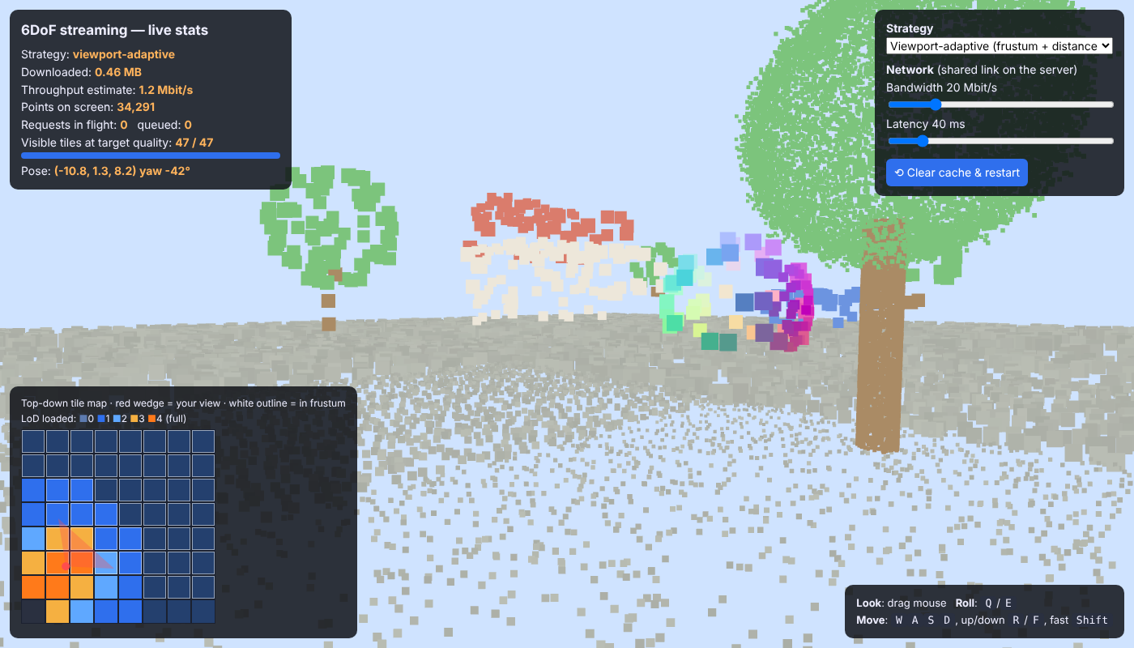
Viewport-adaptive: quality where you look
LIVE DEMO
Bottom-left map: tile colours = loaded LoD, red wedge = your view. Coarse first, refined near you.
Day 15 · Live 6DoF streaming
4
Notes:
Run it live: python server.py, open localhost:8000. Narrate the HUD: downloaded MB, throughput estimate, points on screen, requests in flight, and visible tiles at target quality. Walk forward: tiles near you turn orange (fine) while distant ones stay blue (coarse). Turn around: new tiles are requested coarse first.

Slide 50
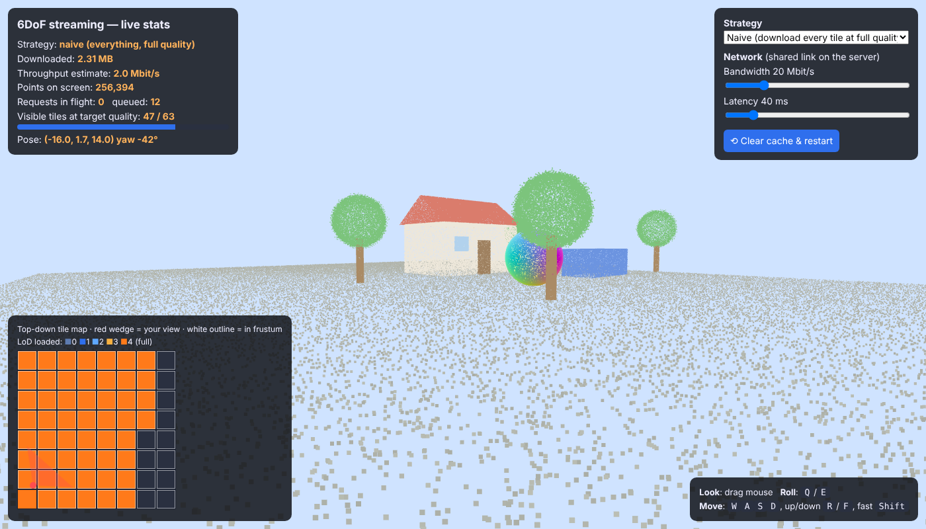
Naive: download everything at full quality
COMPARE
Naive mode ignores the view: it fetches tiles in a fixed order, so at low bandwidth you wait for tiles you cannot even see.
Day 15 · Live 6DoF streaming
5
Notes:
Switch strategy in the dropdown; it clears the cache. At 20 Mbit/s naive looks great after a few seconds, and that is the point to discuss: at 2 Mbit/s naive takes far longer before the view is complete, while adaptive shows a coarse complete view almost immediately. Have students set bandwidth to 2 Mbit/s and race the two modes. Lab L8 question 2 adds a time-to-first-full-view counter to measure this properly.

Slide 51
Try these in class
EXPERIMENTS
Experiment | Set | Watch
Slow network | 2 Mbit/s | Time until visible tiles reach target
High latency | 300 ms | Turning fast: black gaps, late tiles
More parallelism | MAX_INFLIGHT 1 vs 16 | Throughput estimate and fairness
Strategy race | adaptive vs naive | MB downloaded for the same view
Day 15 · Live 6DoF streaming
6
Notes:
Give each group one experiment and 15 minutes, then have each group report one number and one observation. This is a good moment to discuss what metric captures user experience: time to first full view, quality at the centre of view, bytes wasted on invisible tiles.

Slide 52
Run the server and fly through the stream
HANDS-ON LAB · COPY, RUN, LOOK
RUN IT
cd day15_live_6dof_streaming
python server.py
# open http://localhost:8000
python server.py --kbps 3000 # slow link
→ Watch the tile map while you walk and turn.
→ Switch to naive and compare at 2 Mbit/s.
→ Read the server log: which tiles and LoDs?
Day 15 · Live 6DoF streaming
7
Notes:
Most of the session. If several students run servers on one machine, use --port. Capstone teams should form today; track A builds on this system. 60 minutes.

Slide 53
Three things to remember
1
Server = manifest + chunks + a network; client = all the decisions.
2
The client’s loop: frustum, distance, throughput → progressive requests by priority.
3
Good 6DoF streaming shows something useful immediately and refines where you look.
BEFORE NEXT SESSION
Lab L8. Form capstone teams. Next: volumetric video, ABR and QoE.
Day 15 · Live 6DoF streaming
8
Notes:
Recap and preview the final session: dynamic content, adaptive bitrate algorithms, quality of experience and predicting where the viewer will look.

Slide 54
Volumetric video, ABR & QoE
DAY 16 OF 16 · 3D & 6DOF STREAMING
3D that moves: streaming a waving person you can walk around, choosing quality on the fly, and predicting where the viewer will look.
Volumetric video
Bitrate ladder
ABR algorithms
QoE
Pose prediction
Capstone
Book: Ch. 18 + streaming research · Code: day16_volumetric_video_qoe/
Notes:
Final session. It ties everything together: dynamic point clouds, a bitrate ladder like DASH, three ABR algorithms, a QoE score, pose prediction and a working player. End with the capstone briefing and a look ahead to spatial AI (book Chapter 18).

Slide 55
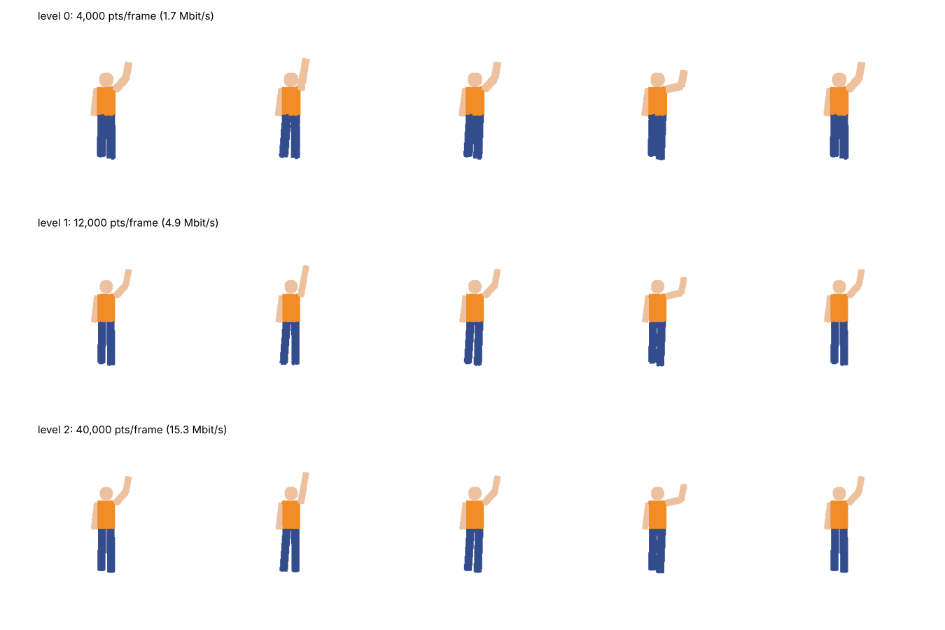
A sequence of point clouds you can walk around
VOLUMETRIC VIDEO
■ Frame = point cloud; 15 fps
■ Ladder ≈ 1.8 / 4.9 / 15 Mbit/s
■ Segments of 1 s, like DASH
■ MPEG standardises this as V-PCC content
3 quality levels: 4k, 12k and 40k points per frame. Each 1-second segment is encoded at all three.
Day 16 · Volumetric video & QoE
2
Notes:
Volumetric video captures a performer with many cameras and produces a 3D frame many times per second. Viewers can watch from any 6DoF pose. Our synthetic person waves an arm; the script encodes 1-second segments at three levels and prints the bitrate ladder: about 1.8, 4.9 and 15 Mbit/s. Compare with Day 12’s table: even the top level is far below the raw 360 Mbit/s thanks to fewer points and quantisation.

Slide 56
Three ways to choose the next segment’s quality
ADAPTIVE BITRATE
Fixed
Throughput-based
Buffer-based (BBA)
Always the best level. Great until the network dips.
Highest level below 80% of recent measured throughput. Reacts to the network; can be over-cautious.
Low quality when the buffer is nearly empty, high when it is full. Uses the buffer as the signal (Huang et al., SIGCOMM 2014).
01
02
03
Day 16 · Volumetric video & QoE
3
Notes:
These are the classic families of ABR. Throughput-based is the oldest; buffer-based was popularised by Netflix researchers (Huang et al. 2014). Hybrid and optimisation-based approaches such as MPC (Yin et al., SIGCOMM 2015) and learning-based approaches such as Pensieve (Mao et al., SIGCOMM 2017) combine both signals. For volumetric video, research adds the viewport: quality can also depend on which side of the person you look at.

Slide 57
One number to compare algorithms
QUALITY OF EXPERIENCE
QoE = Σ bitrate − μ · stall seconds − Σ |bitrate change|
Bitrate
μ · stall
Switches
Higher quality is better.
Stalls hurt most; μ = top bitrate, so 1 s of stall costs 1 s of top quality.
Frequent quality jumps are annoying.
Day 16 · Volumetric video & QoE
4
Notes:
This linear QoE model is the one used in the MPC and Pensieve papers. Results from our simulation, reported per segment: fixed-high 4.0 (44 seconds of stalls), throughput-based 4.5 (no stalls but low quality), buffer-based 10.8 (no stalls, high quality, 7 switches). Point out that the ranking depends on the weights and the network trace, which is why research papers test many traces.

Slide 58
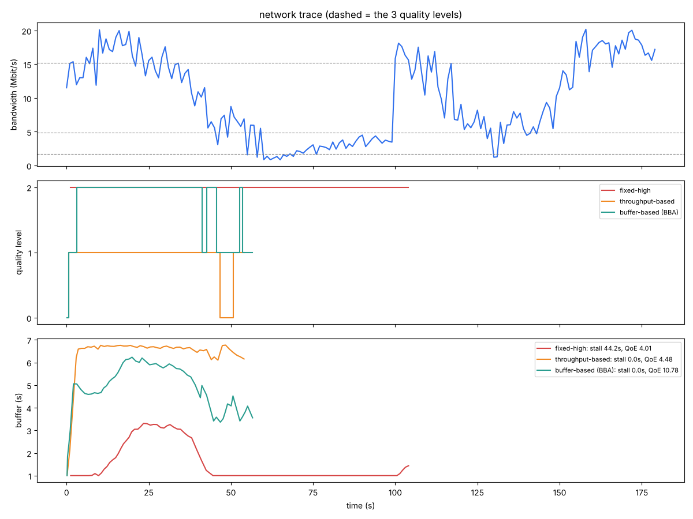
Buffer-based ABR wins on this trace
LAB RESULT
■ Fixed-high: QoE 4.0, 44 s stalled
■ Throughput: QoE 4.5, cautious
■ Buffer-based: QoE 10.8
■ Ranking depends on the network trace
Fixed-high stalls 44 s. Throughput-based never stalls but stays low. BBA keeps a buffer and quality high.
Day 16 · Volumetric video & QoE
5
Notes:
Read the three panels top to bottom: the network trace with a long congestion episode; the chosen quality level over time; the buffer. Fixed-high (red) empties the buffer in the congestion and stalls. Throughput-based (orange) is safe but cautious. BBA (green) drops quality early when the buffer falls and climbs back when it refills. Ask: what would happen to BBA with a much smaller buffer cap? It would have less room and switch more.

Slide 59
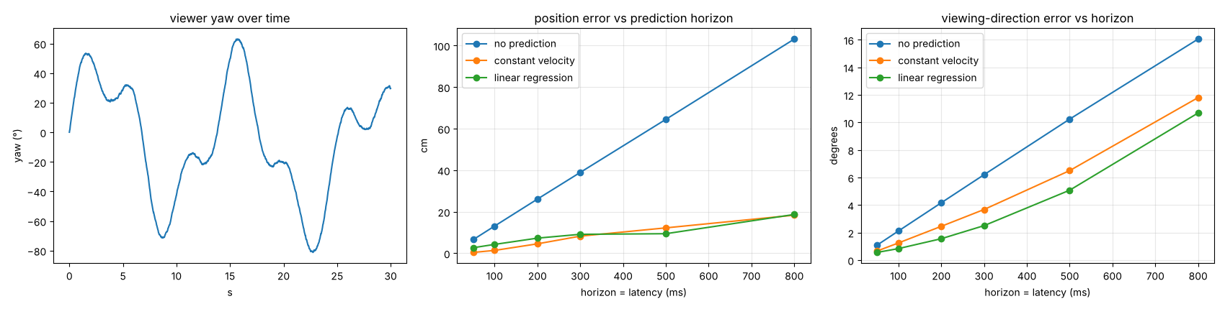
Predict where the viewer will be
POSE PREDICTION
At 300 ms, ‘no prediction’ is off by 39 cm and 6°; constant velocity cuts that to 8 cm and 4°.
Day 16 · Volumetric video & QoE
6
Notes:
Because requests take time, the client must fetch content for the FUTURE pose. The script compares no prediction, constant velocity and linear regression across horizons from 50 to 800 ms on a synthetic trace, or on the student’s own Day 11 trace. Errors grow with the horizon, which is why low latency matters even for content streamed ahead. Practical rule: for long horizons, fetch a wider margin around the predicted view. Research uses neural predictors and saliency for longer horizons.

Slide 60
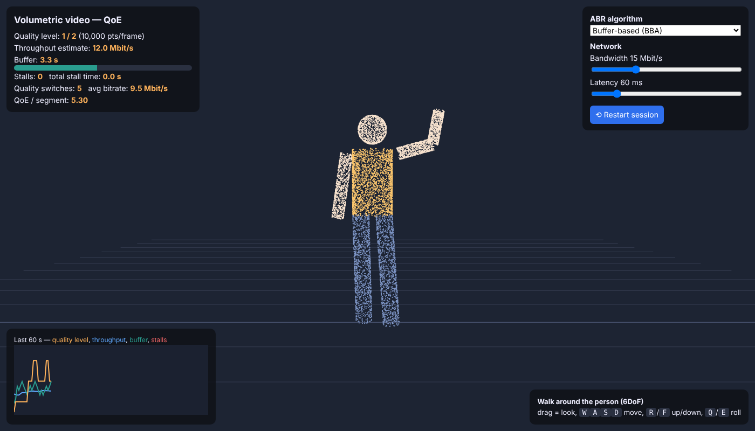
The volumetric video player
LIVE DEMO
python vv_server.py → localhost:8001. Switch ABR, drag the bandwidth slider, walk around the person.
Day 16 · Volumetric video & QoE
7
Notes:
Run it live. Start with BBA at 15 Mbit/s, then drop to 5 Mbit/s and watch the level and buffer react. Switch to Fixed HIGH and the ‘Buffering…’ overlay appears. The chart shows quality, throughput, buffer and stall periods. Walk around the person with WASD to show this is 6DoF content.

Slide 61
Build a 6DoF streaming experience
CAPSTONE
A. Static scene
B. Volumetric video
C. Research replication
Stream your own scan with the Day 15 system plus two improvements.
Extend the player: compression, better ABR, view-dependent quality.
Re-implement a simplified paper idea and evaluate it with our tools.
01
02
03
Day 16 · Volumetric video & QoE
8
Notes:
Brief the capstone using the assignments document: teams of 2 to 3, demo that runs in under 5 minutes, 4-page report with experiments under at least 3 network conditions, 5-minute talk. Rubric: technical quality 10, experimental method 8, demo 6, clarity 6.

Slide 62
Spatial AI needs 3D worlds that travel.
THE BIG IDEA
Digital twins, telepresence, robots and AR glasses all need accurate 3D environments, delivered fast enough to feel real.
Day 16 · Volumetric video & QoE
9
Notes:
Close the course with the book’s final theme: from 3D generative AI to spatial AI. The book’s first chapter described spatial AI as perception, reasoning and action. This course added the missing piece for many applications: moving 3D worlds across networks under tight latency. Thank the students and open the floor for capstone questions.

Slide 63
Three things to remember
1
Volumetric video = point cloud frames, encoded as a bitrate ladder of segments.
2
ABR chooses quality from throughput and buffer; QoE punishes stalls hardest.
3
6DoF clients predict the pose and fetch ahead; better prediction means fewer gaps.
BEFORE NEXT SESSION
Capstone: demo next week, report one week later.
Day 16 · Volumetric video & QoE
10
Notes:
Final recap of the whole course on one line each: what 3D is, how it is captured and organised, how it is compressed, how it is streamed adaptively to a 6DoF viewer. Remind students about capstone deadlines and office hours.

